Slide 1


Maths from around the world

Slide 2

Notes:
Maths is a part of everyday life for all of us. Can you think of anything that you have counted recently? (pair and share)

Slide 3
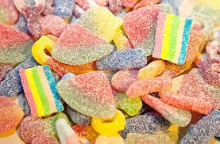
Notes:
Perhaps you counted sweets?

Slide 4
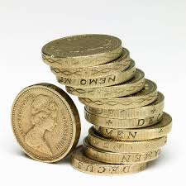
Notes:
Money?

Slide 5
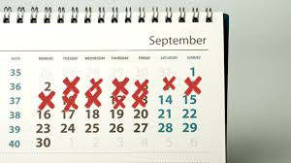
Notes:
Days until your birthday?

Slide 6
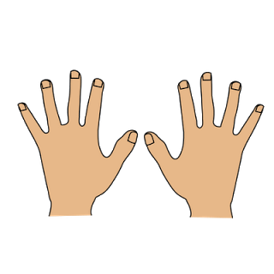
Notes:
It’s easy enough when it’s small numbers (I still use my fingers!). But when it’s a bigger number you might need to write it down…

Slide 7
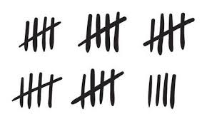
Notes:
Talley marks are one way people have counted in the past and still do now….

Slide 8
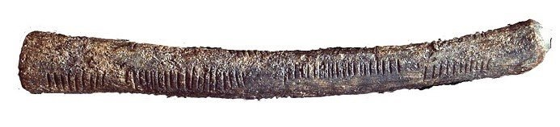
Notes:
This is a picture of a bone found in Lembombo in S Africa. IT’s over 35 000 years old. If you look carefully you can see 29 notches carved into the side of the bone….

Slide 9
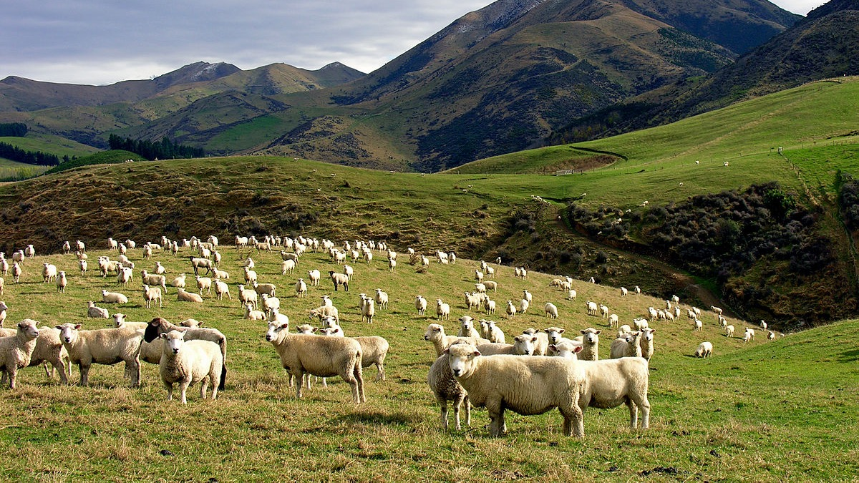
Notes:
In the past people might have needed to count the animals they owned –like sheep or cattle.

Slide 10
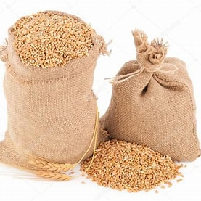
Notes:
Or sacks of wheat…

Slide 11
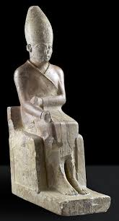
Notes:
Or if you were King Khasekhem from Ancient Egypt, the number of enemies you’d killed in battle!

Slide 12
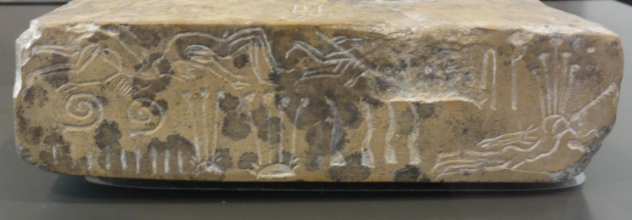
Notes:
Does anyone know the name of the Egyptian number and letter writing system? Hieroglyphics,
Each group of people had their own ways in the past of writing down and recording what they’ve counted. The Egyptians used Hieroglyphics to record sounds and numbers.

Slide 13
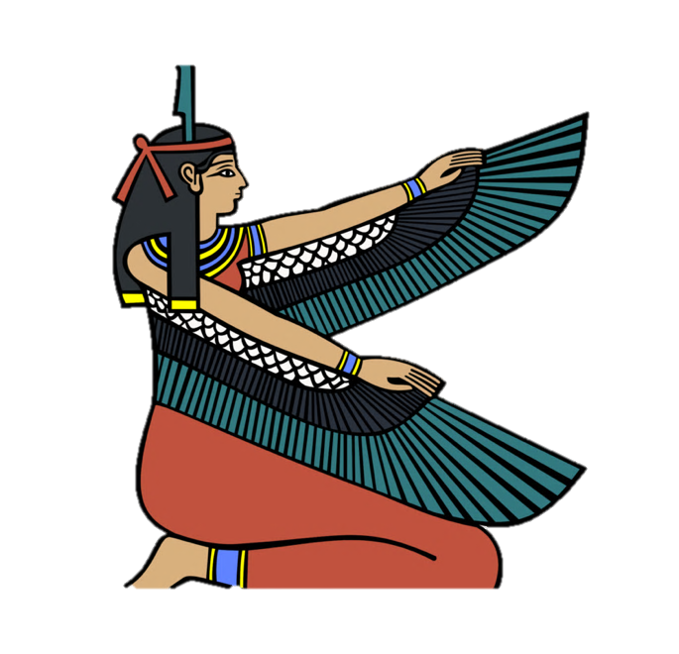
Activity 1:
Egyptian Numerals
Notes:
Let’s see if we can get you counting using hieroglyphics…..
Miss Austin should have some Egyptian counting sheets to hand out

Slide 14
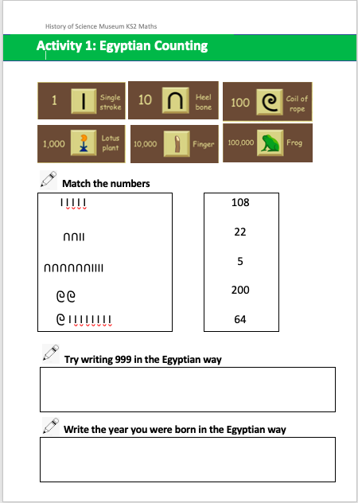
Notes:
On the top of the sheet you can see the different value each symbol was given.

Slide 15
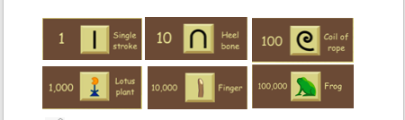
Notes:
On the top of the sheet you can see the different value each symbol was given [read out]. Can you match the Egyptian number to how we would right it today? And if you’ve finished that have a go at a couple of the other questions….Your teacher can tell me when she feels you’ve had enough time

Slide 16
Notes:
So how do you write 108 in hieroglyphics etc (go down)?

Slide 17



Notes:
An improvement on talley marks (would take you a long time to write 200!)
Does the length of the number in hieroglyphics link to how big the number is? No! (64 is longer than 200!)
Is it quick to write 999? (next slide)

Slide 18



999
Notes:
No!! 27 penstrokes. What about your year of birth – which year were you born?

Slide 19
2010

Slide 20
2011

Slide 21
2012

Slide 22
2013

Slide 23
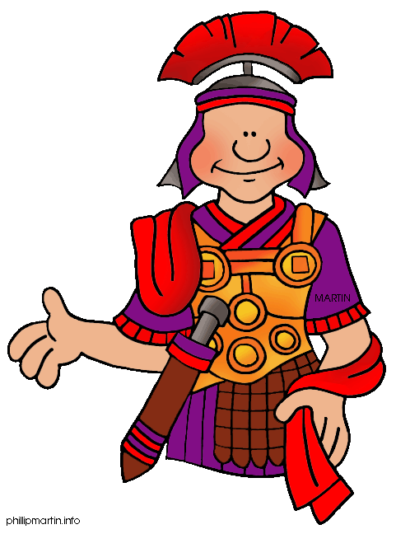
Roman Numerals
Notes:
So have any of you come across Roman Numerals before? What did they use instead of pictures?

Slide 24
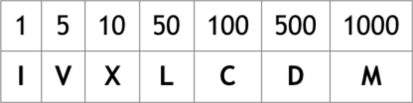
Roman Numerals

Slide 25
1 I
2
3
4
5
Notes:
Counting 1 to 3 pretty straight forward….

Slide 26
1 I
2 II
3
4
5

Slide 27
1 I
2 II
3 III
4
5
Notes:
4 is a bit trickier…

Slide 28
1 I
2 II
3 III
4 IV
5

Slide 29
1 I
2 II
3 III
4 IV
5 V

Slide 30
1 I 6
2 II 7
3 III 8
4 IV 9
5 V 10

Slide 31
1 I 6 VI
2 II 7
3 III 8
4 IV 9
5 V 10

Slide 32
1 I 6 VI
2 II 7 VII
3 III 8
4 IV 9
5 V 10

Slide 33
1 I 6 VI
2 II 7 VII
3 III 8 VIII
4 IV 9
5 V 10

Slide 34
1 I 6 VI
2 II 7 VII
3 III 8 VIII
4 IV 9 IX
5 V 10

Slide 35
1 I 6 VI
2 II 7 VII
3 III 8 VIII
4 IV 9 IX
5 V 10 X

Slide 36
Activity 2:
Roman Numerals

Slide 37
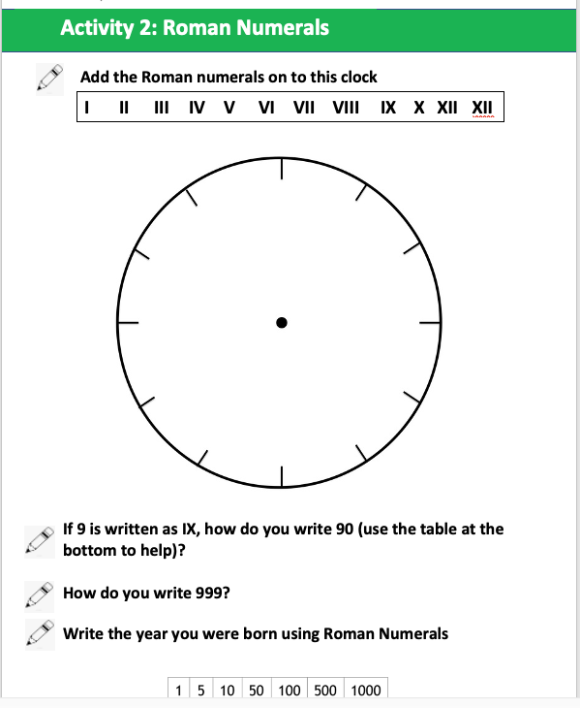
Notes:
Have a go at this sheet. Start by adding the Roman numerals to the clock and then see how you get on…

Slide 38
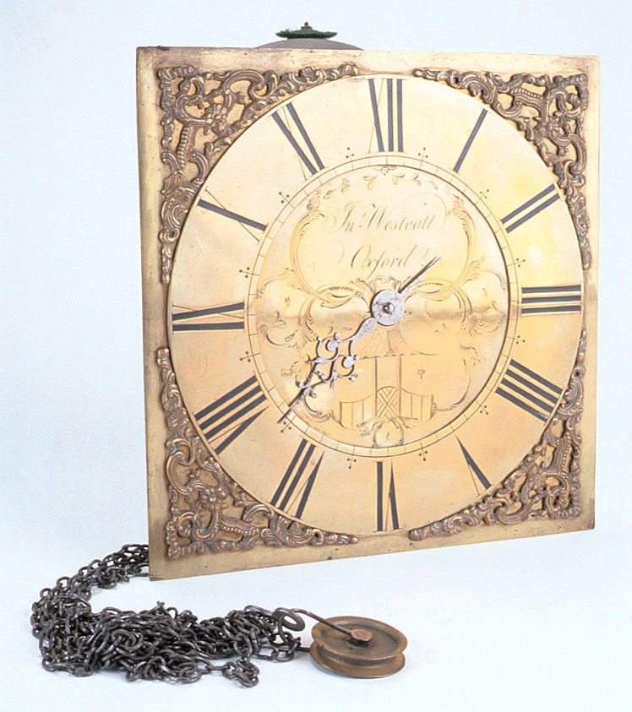
Notes:
Your clock should look like this (this is an old clock from the History of Science Museum) with 1 difference – can you work out what that difference is? 4 written as IIII. We don’t know why that is!!! [The reason that older clocks often have Roman Numerals is that the first mechanical clocks often appeared on Churches, and Latin –the language of the Romans – used to be the official language of Christian church (so it made sense that they used Roman numbers)

Slide 39
999
Notes:
How do you write 999 is Roman numerals? Let’s see if you’re right….

Slide 40
Roman Numerals
IX = 9

Slide 41
Roman Numerals
IX = 9
XC =90

Slide 42
Roman Numerals
IX = 9
XC =90
CM =900

Slide 43
999
CMXCIX
Notes:
Which do you find easier – Roman numerals or Egyptian hieroglyphics? Let’s have a vote….

Slide 44

Place Value
Notes:
I personally love the number system we use now….Place Value!!

Slide 45
999
CMXCIX
Notes:
999 in Egyptian had 27 pen strokes or symbols
Using Roman numerals had 6 symbols
Our way of writing 999 (called Hindu Arabic numbers) just uses 3 symbols
The same number 9 has a different value depending on where it’s positioned (so 9 at the end of the number worth 9 units, in centre worth 90 and on left work 900)

Slide 46
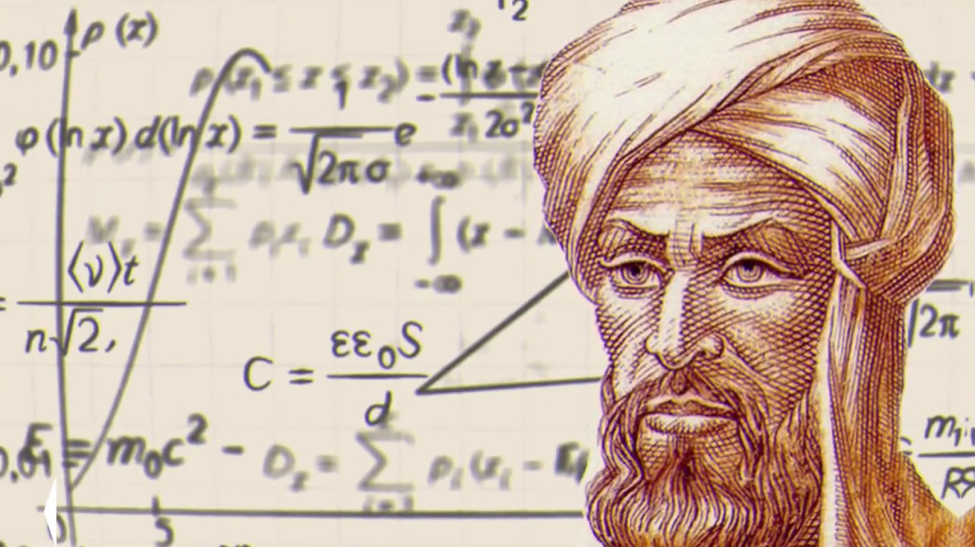
Al Khwarimzi
Notes:
We have our understanding of place value and this sytem of writing numbers, with thanks in particular to this person here – Al Khwarizmi, a muslim mathematician from Baghdad who wrote books about number. He translated books from different places in the world and learnt about the way that Hindu people (modern day India) wrote numbers.
In the year 976, al Khwarizmi stated that if no number appears in the place of tens in a calculation, a little circle should be used "to keep the rows". This circle was called ṣifr (empty in Arabic)-where our word for zero comes from.

Slide 47
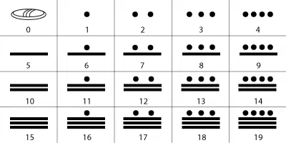
Maya Number System
Notes:
Quite separately, the Maya people from South America had invented the idea of zero and were using it around 500 years before this. They used a shell to show ‘zero’. They also used a type of place value (meaning the value of a number was dependent on where it was placed.

Slide 48
Gallery Tour
Notes:
So now we’re going to show you 3 inventions from the History of Science Museum that have helped people calculate numbers….

Slide 49
Ada Lovelace

Slide 50
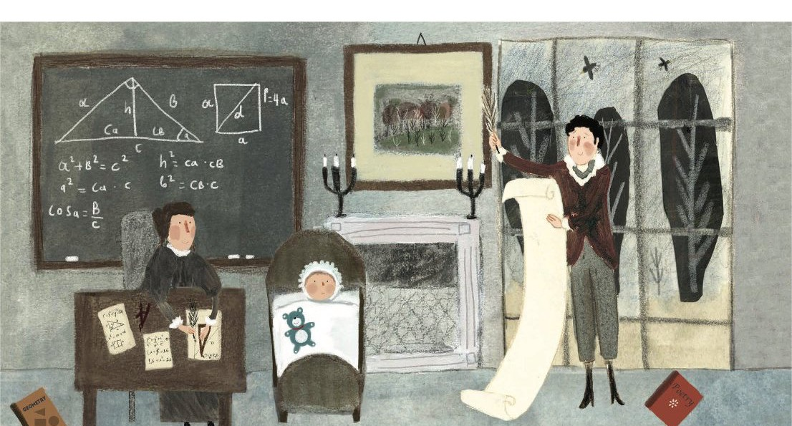

Slide 51
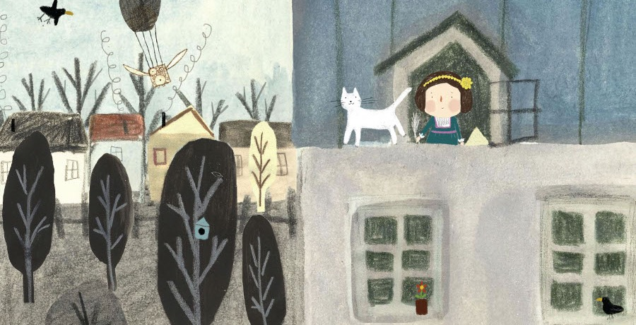

Slide 52
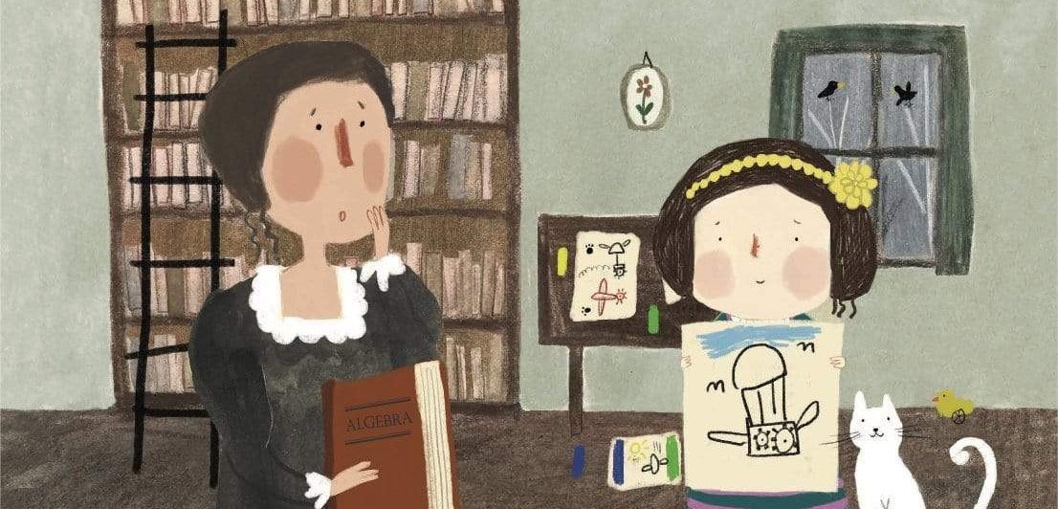

Slide 53
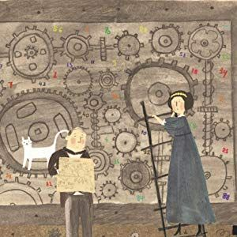

Slide 54
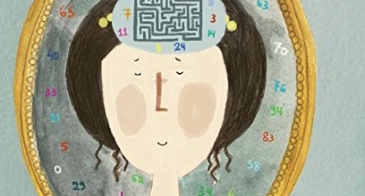

Slide 55
Binary Numbers

Slide 56
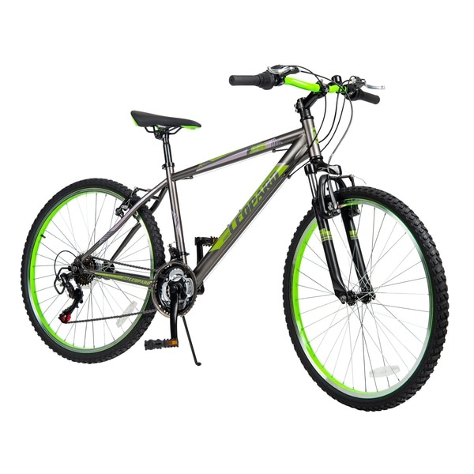


Slide 57


Slide 58
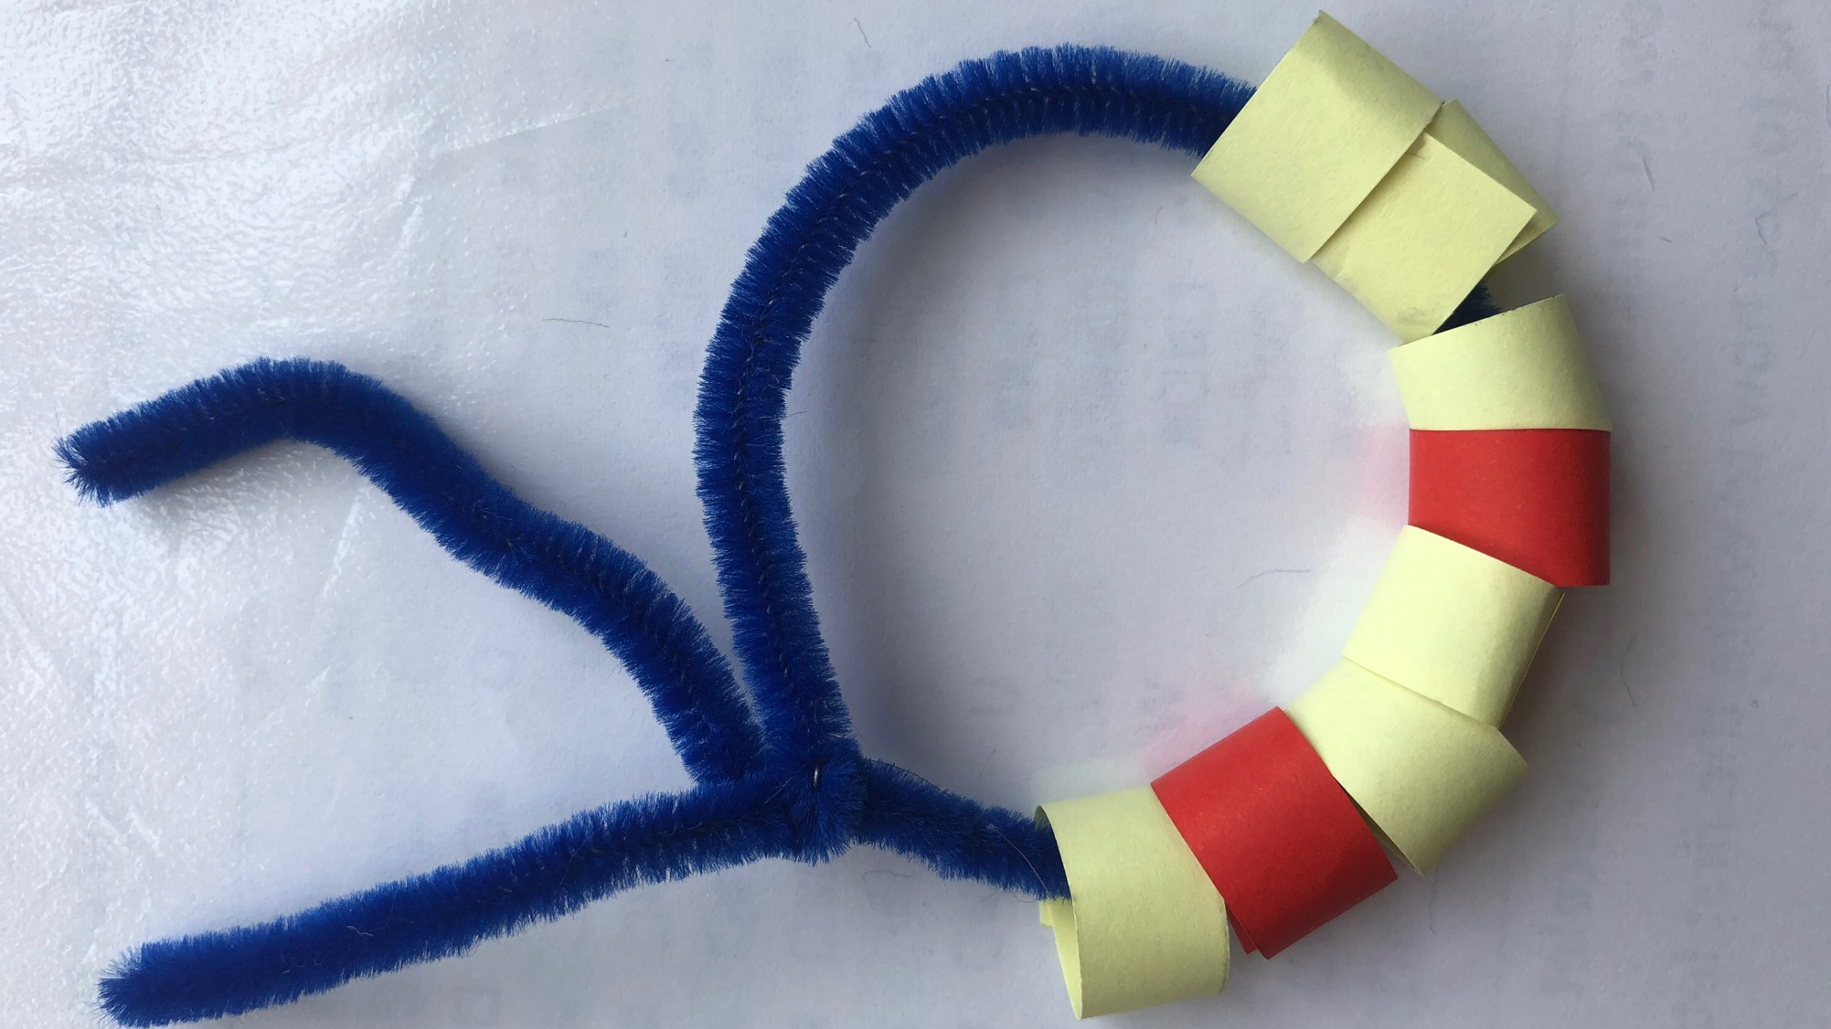
Make a binary bracelet

Slide 59

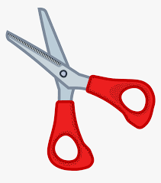
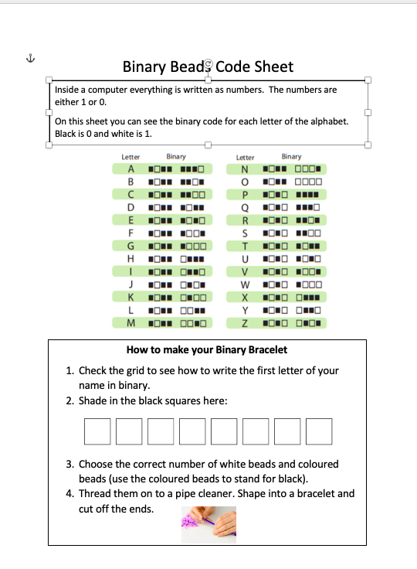
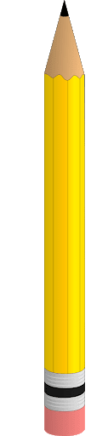




Slide 60
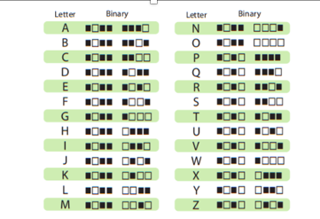
Check how to write the first letter of your name in binary. Shade in the squares.

Slide 61

Make the beads from the 2 different colours of papers
Cut strips that are 1cm across and 5cm long to make your bead

Slide 62
Add the glue to one tip to make circles that you can thread on to your pipe cleaner.
Remember to thread them in the correct order!!

Slide 63
